Slide 1
AI-Powered Expense Audit & Analytics Platform
Automated expense tracking, multi-segment trend line analysis, and dynamic audit ledger for modern agricultural or any business operations.
By
Daniel N

Slide 2
Problem Statement:
Rural agri-business owners, farm operators, and small-shop proprietors manage complex financial lifecycles spanning multiple domains—farming inputs, commercial store operations, household expenses, and agricultural loans.
Fragmented Data Sources
Lack of Categorization
Lack of Historical Traceability

Slide 3
Objectives
Unified Multi-Channel Ingestion
Automated Semantic Categorization
Persistent Dual-Storage Architecture
AI-Powered RAG Auditing
Interactive Financial Analytics Dashboard
Provide real-time KPI overview cards, flexible timeline filters, and multi-segment trend line visualizations using Plotly.

Slide 4
Tools and Techonologies:
Streamlit:
Pandas:
CSV Persistence (master_ledger.csv):
Pinecone (expense-audit-index):
OpenAI Embeddings
Python PyPDF & RegEx:

Slide 5
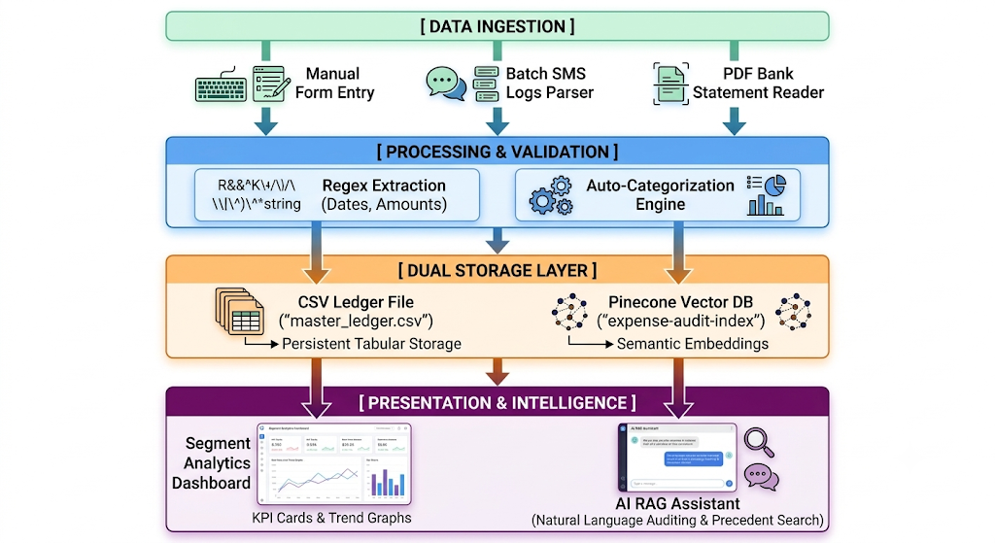
Project Work-Flow Diagram

Slide 6
Conclusion
The Agri-Business Financial Audit Platform successfully bridges the gap between traditional agricultural bookkeeping and modern AI-driven financial intelligence. By combining robust local data persistence (master_ledger.csv), lightning-fast cloud vector search (Pinecone), and natural language processing (OpenAI RAG)

